Slide 1
Mobile and Embedded Computing
Lecture 0. Course orientation

Slide 2
Ing. Dinu-Ștefan RUSU
You can contact me on:
dinu_stefan.rusu@upb.ro
Teams
Senior Engineer @ Dell [Kotlin, Spring Boot]
45+ Launched apps on Google Play & App Store [Flutter, Java]
Speaker at DevTalks 2025 – Scaling Flutter to 100k MAU as a solo dev

Slide 3
Course Topics
1. Git & GitHub, Web vs PWA vs Cross platform vs Native, Overview of SSR, SSG, CSR
2. Compiled vs Interpreted languages, Null safe languages, Dart & Flutter
3. Agent assisted coding, Async vs Threads, Flutter Widgets & UI Elements
4. Stateless vs Stateful, State management techniques (introduction)
5. Server vs Client-Side code execution, Serverless vs VPS (+ http & Firebase)
6. GraphQL & REST, Observability for Mobile applications (Events, Crashlytics)
7. Web Sockets, Permissions & routing
8. State management techniques, Business Logic Component (BLoC) pattern
9. Authentication, OAuth providers, Firebase App Check
10. AI On-device (Google ML Kit for Flutter) & Connecting to LLMs (VertexAI)
11. Deploy to stores (Google Play, App Store) & CI/CD With GitHub Actions
12. Performance and Energy Consumption

Slide 4
Grading
Final grade (10p)
4p (Exam)
+ 4p (Laboratory)
+ 2p (Course Test)
Requirements
In total ≥ 5
(Exam + Lab + Course Test)

Slide 5
Laboratory – 4P
Hands-on Flutter exercises
4 Milestones:
1. Build basic UI (0.5p)
2. Integrate with the provided API (0.5p)
3. State management & Offline first (1p)
4. Final presentation (2p)

Slide 6
Course test – 2P
Written theory, on paper
1h
During lecture hours
Final exam – 4P
Written theory, on paper
During exam session
Bonus points
Kahoot
Course answers

Slide 7
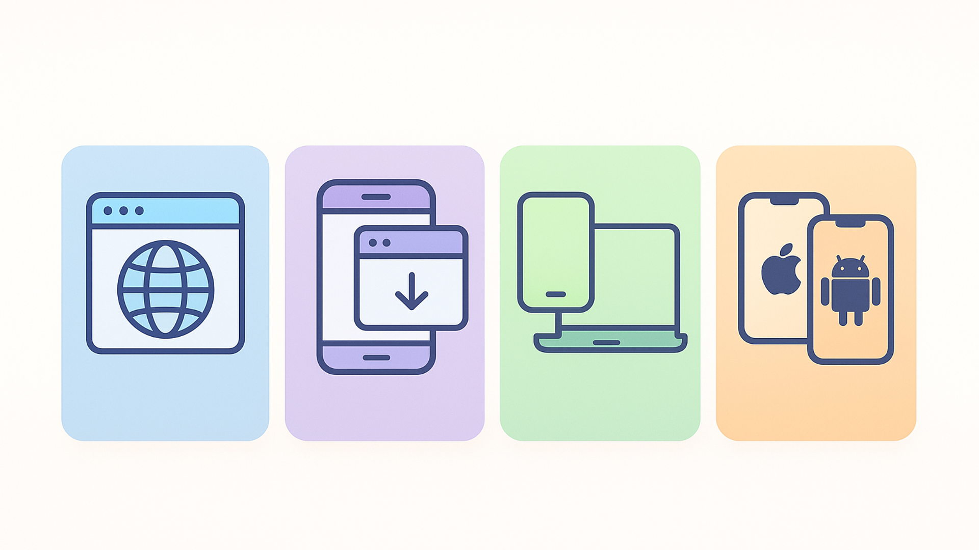
Lecture 1. Platforms & Technology

Slide 8
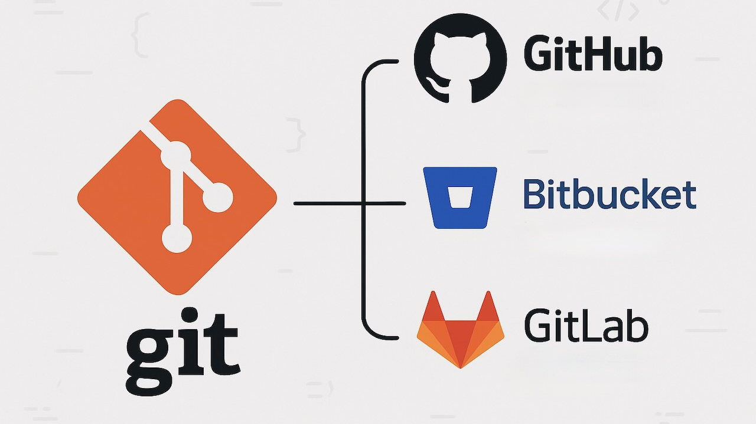

Slide 9

Git is a version control system, designed to handle everything related to source code management
Used to track changes in the source code, enabling multiple developers to work together

Slide 10

It is mandatory to create a GitHub account at https://github.com/signup
You can find all the resources you need in this repository: https://rusudinu/mobile-and-embedded-computing

Slide 11
A repository contains all the files of your project, and each revision of it
It contains at least one branch (main/master)
A repository is a Git ‘concept’, and NOT a GitHub one

Slide 12

Branches allow contributors to develop features, fix bugs or experiment new ideas without impacting other team members.
A branch is created from an existing branch.

Slide 13
A pull request is an event that takes place when a contributor is ready to begin the process of merging new code changes with the main project branch.
After a peer review, a pull request may or may not be approved.
If approved, it may be merged, otherwise the author must make the requested changes until he receives all the required approvals.

Slide 14
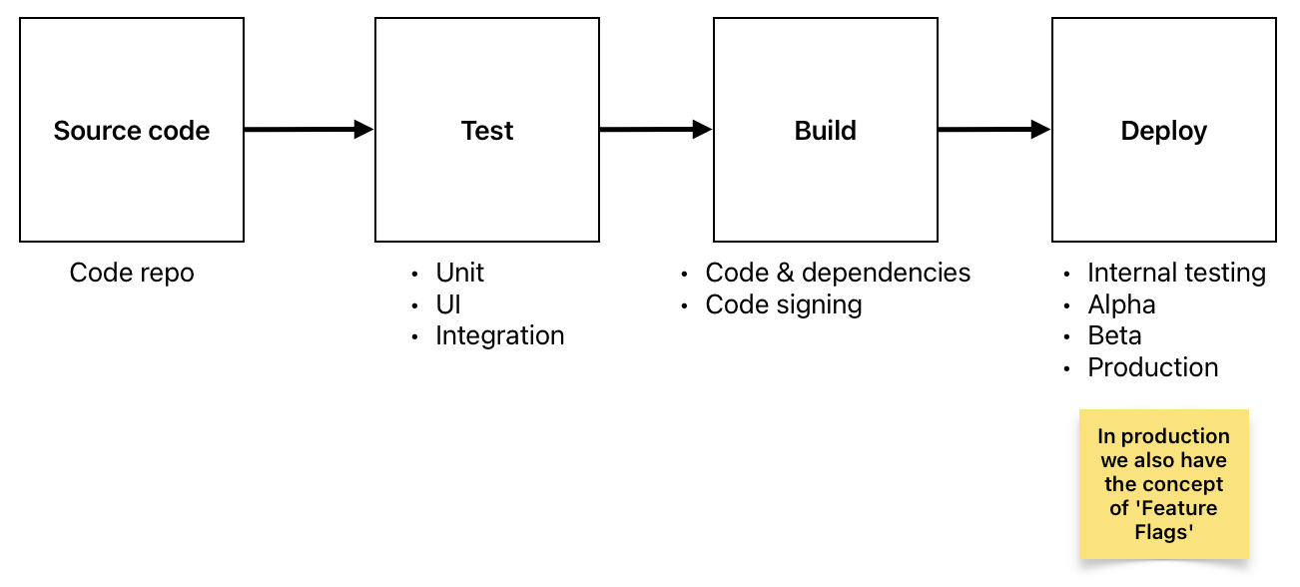

Slide 15
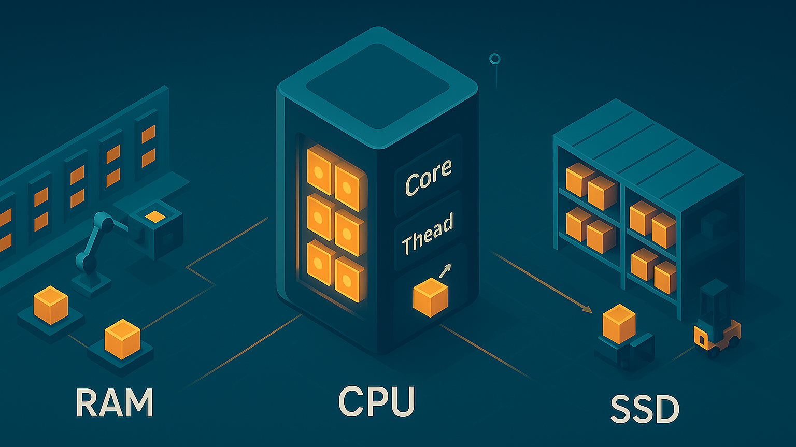

Slide 16
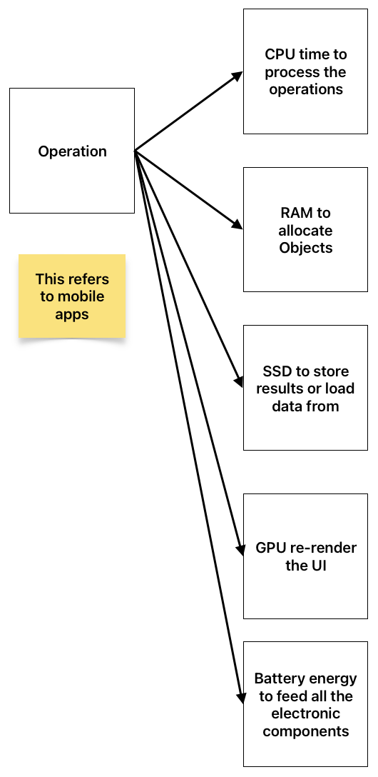
Device resources
CPU
RAM
SSD
GPU
For mobile devices, the battery is also a ‘resource’

Slide 17
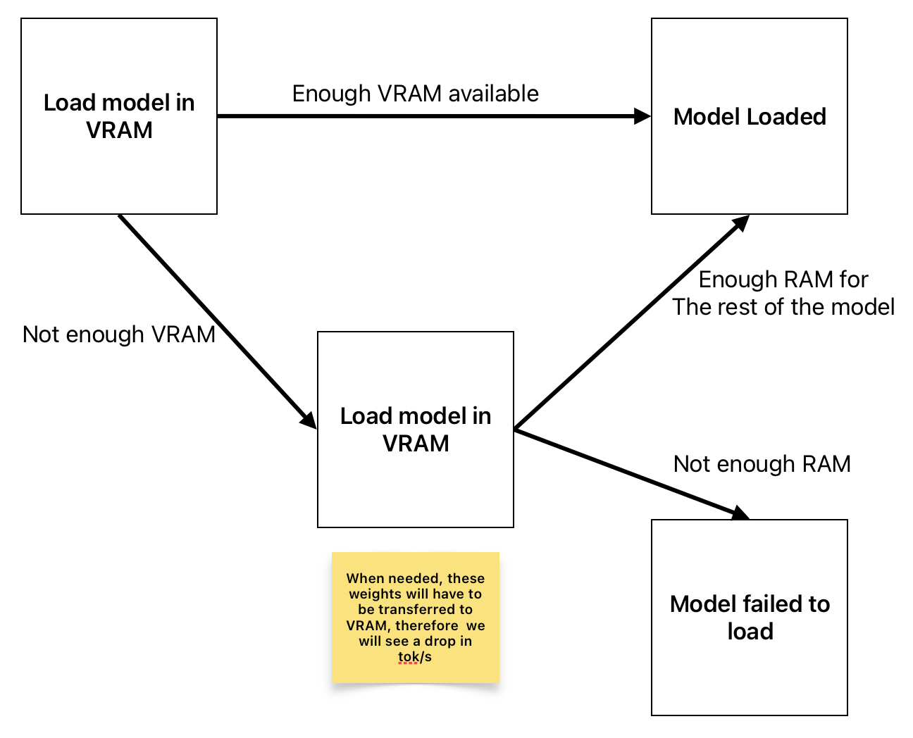
Resource allocation for LLMs
When you try to load a Large Language Model (LLM), the operating system will do the following
’Unified memory’ in MacBooks is very useful for LLMS because you have a lot more ‘VRAM’ available

Slide 18
Web App
Runs in a web browser instead of being installed directly on a device like a Desktop App / Mobile App
Is accessed using a URL (e.g. https://rusudinu.ro)
No installation needed
Cross platform ‘by default’
Usually require an active internet connection
The content & functionality updates in real time
‘Plain’ HTML & Js, Angular, React, Vue, Svelte, etc

Slide 19
Progressive Web App (PWA)
‘Modern’ technologies making a website behave like a mobile app
Installable
Capable of working offline
HTTPs only
Cross platform
Updates are automatically checked in the background by the service worker and are applied when the app is opened the next time
‘Plain’ HTML & Js, Angular, React, Vue, Svelte, etc

Slide 20
Cross Platform Apps
Most of the code is written once and the app will run on Android and iOS
Better performance compared to PWA
Slower to update, need to go through the Store review process (except for some cases like parts of React Native apps that can receive OTA (Over the Air) updates)
Some have Desktop support (Flutter)
Can work well fully offline
Flutter, React Native, Kotlin Multiplatform, etc
Published in Google Play, App Store

Slide 21
Native Apps
Platform specific, built for one OS (iOS or Android)
iOS -> Swift / ObjC in Xcode
Android -> Kotlin / Java in Android Studio
Can work well fully offline
Best performance
Use native components
Published in Google Play, App Store

Slide 22
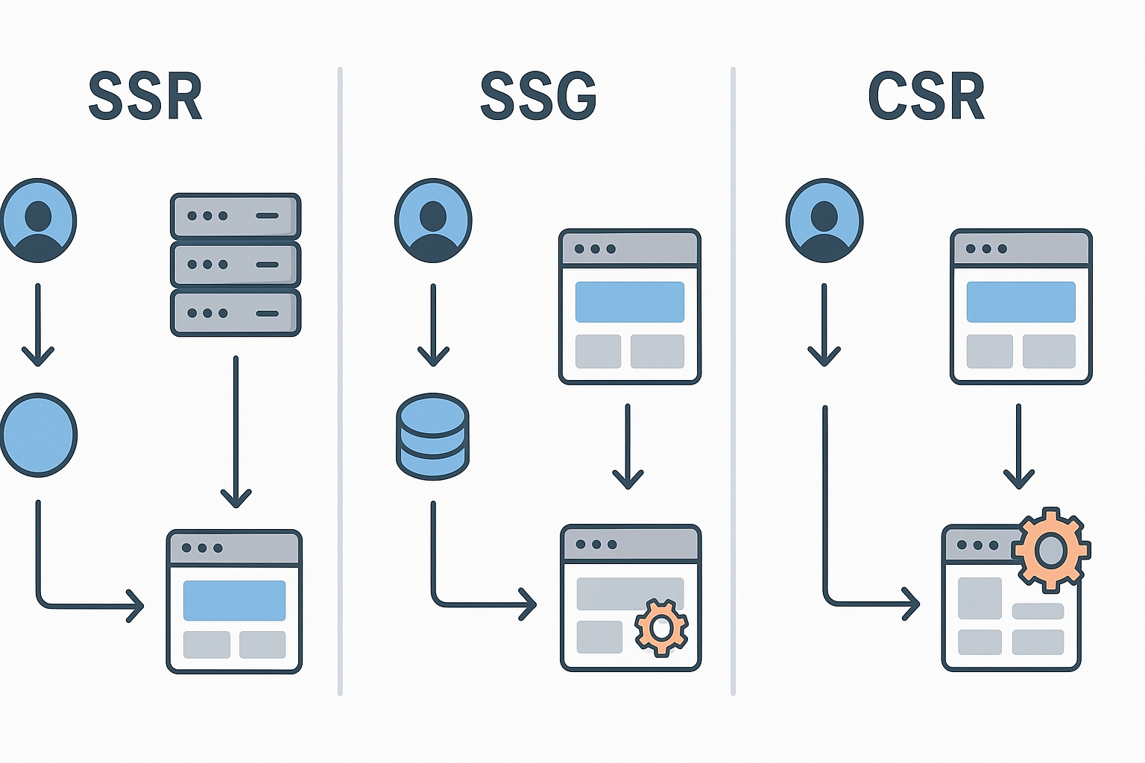

Slide 23
Server Side Rendering (SSR)
HTML is generated on the server for each request
Better SEO since content is immediately available to crawlers
Faster initial page load and Time to First Contentful Paint (TTCP)
Higher server load as each request requires processing
Slower navigation between pages (full page reloads)
Examples: Next.js with getServerSideProps, Nuxt.js, SvelteKit
Ideal for dynamic content that changes frequently

Slide 24
Static Site Generation (SSG)
HTML pages are pre-built at build time
Excellent performance with fast loading times
Great SEO as content is fully rendered in HTML
Can be served from CDNs for global distribution
Limited to content known at build time
Requires rebuilding and redeploying for content updates
Examples: Next.js with getStaticProps, Gatsby, Astro, Jekyll
Used for documentation

Slide 25
Client Side Rendering (CSR)
JavaScript runs in the browser to generate the page content
Smooth user experience with fast navigation after initial load
Rich interactivity and dynamic user interfaces
Slower initial page load as JS bundle must be downloaded and executed
Poor SEO without additional optimization (crawlers see empty page initially)
Examples: Create React App, Vue CLI apps, traditional SPAs
Best for highly interactive applications and dashboards

Slide 26
Hybrid approaches
Incremental Static Regeneration (ISR): Combines SSG with on-demand regeneration
Partial Hydration: Only hydrates interactive components on the client
Islands Architecture: Static HTML with interactive "islands" of JavaScript
Universal/Isomorphic: Same code runs on server and client
Modern frameworks like Next.js, Nuxt.js, and SvelteKit support multiple strategies

Slide 27


